Slide 1
中国ORP 审批共享平台
China ORP Approval Tracking Platform (COAT Project)
Heidi Zheng
Partner Program Team, GCR

Slide 2










“COAT” Project Agenda
1
Why we need ORP Approval Tracking Platform (COAT)？
What our expectation for “COAT” Platform?
2
Who will be beneficial form “COAT” Platform?
3
Data Resource & Supports Required by “COAT”
4
Q&A
5

Slide 3
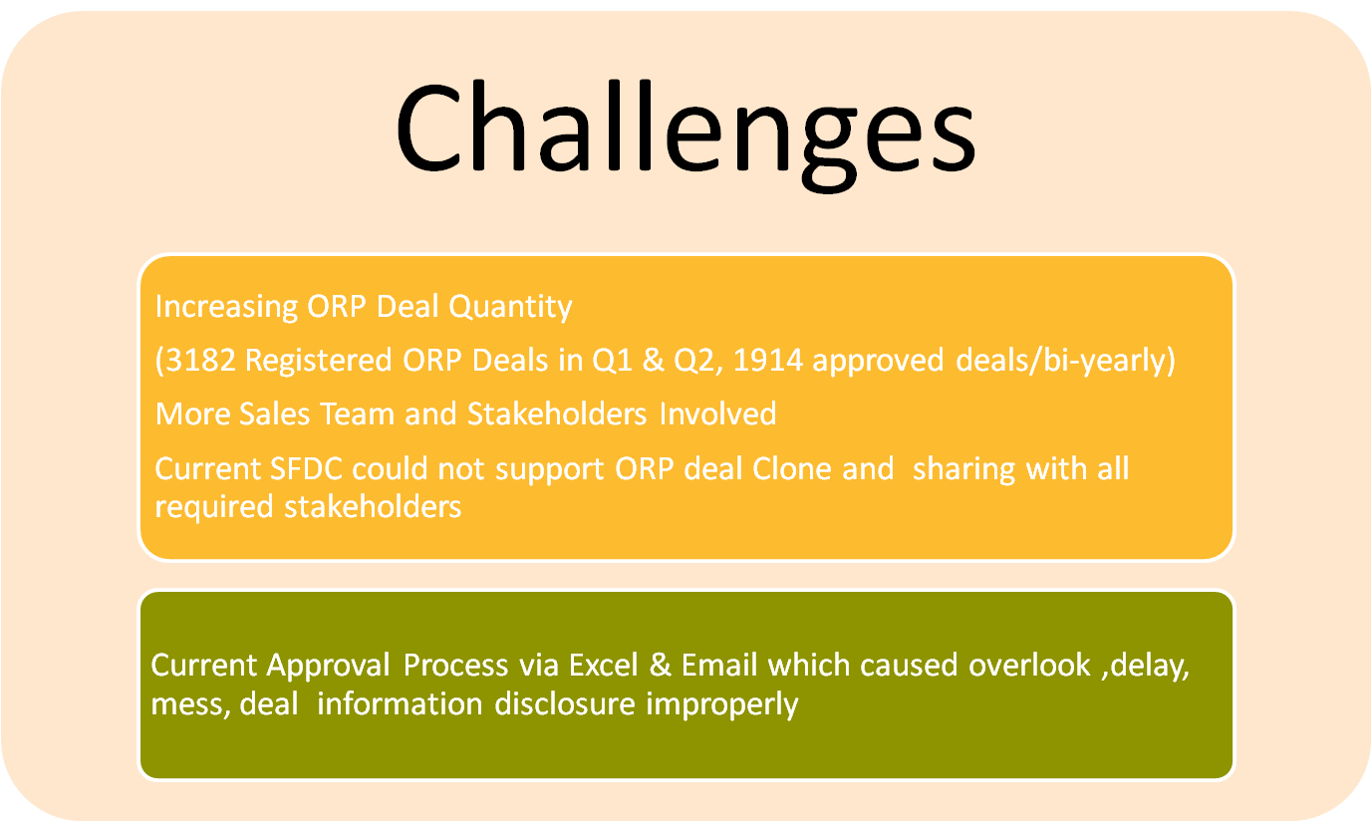
Why We Need COAT ?
(China ORP Approval Tracking Platform)
Notes:
3182 Opportunities in China in Q1 & Q2, 1914 ORP Approved .

Slide 4
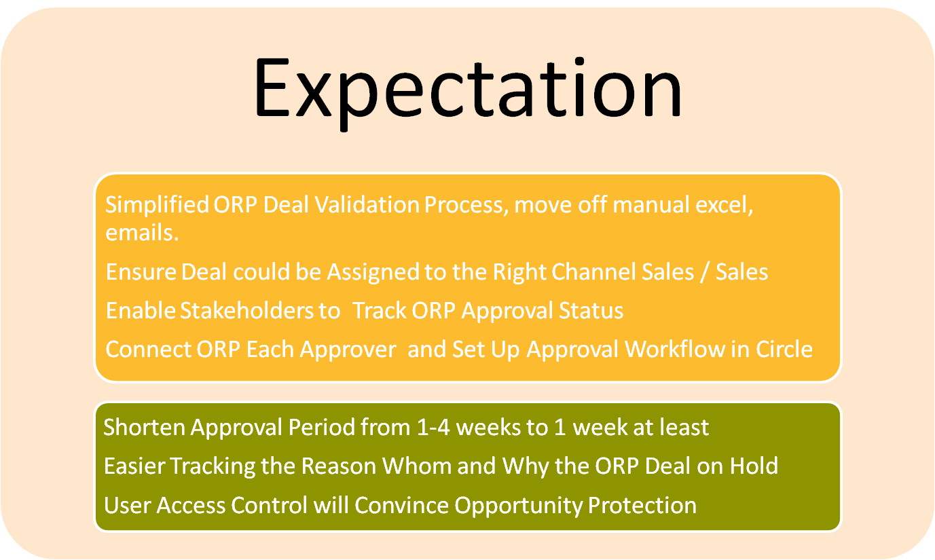
What Our Expectation for “COAT” Platform

Slide 5
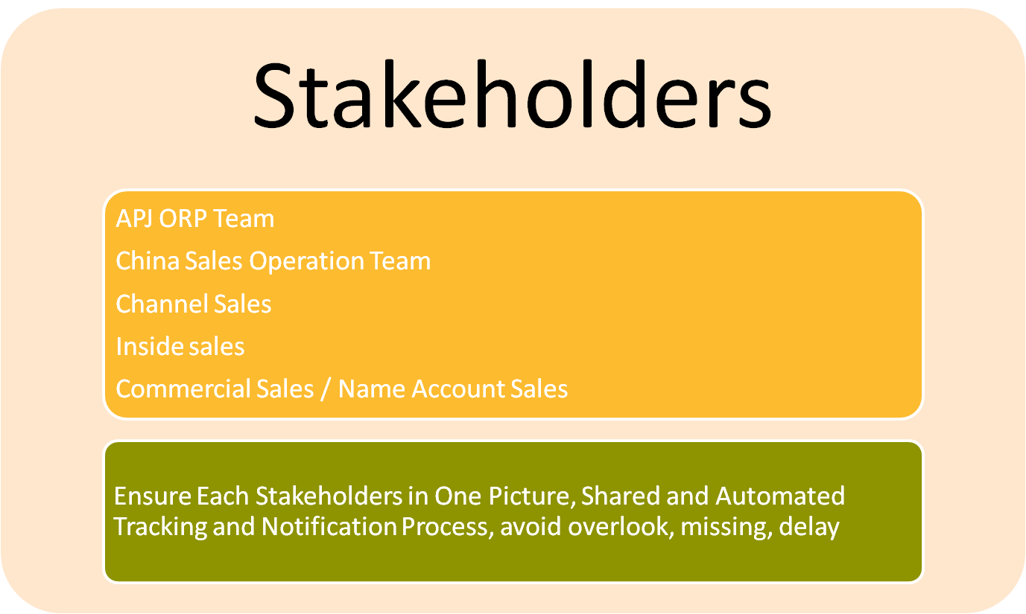
Who will be beneficial form “COAT” Platform?

Slide 6
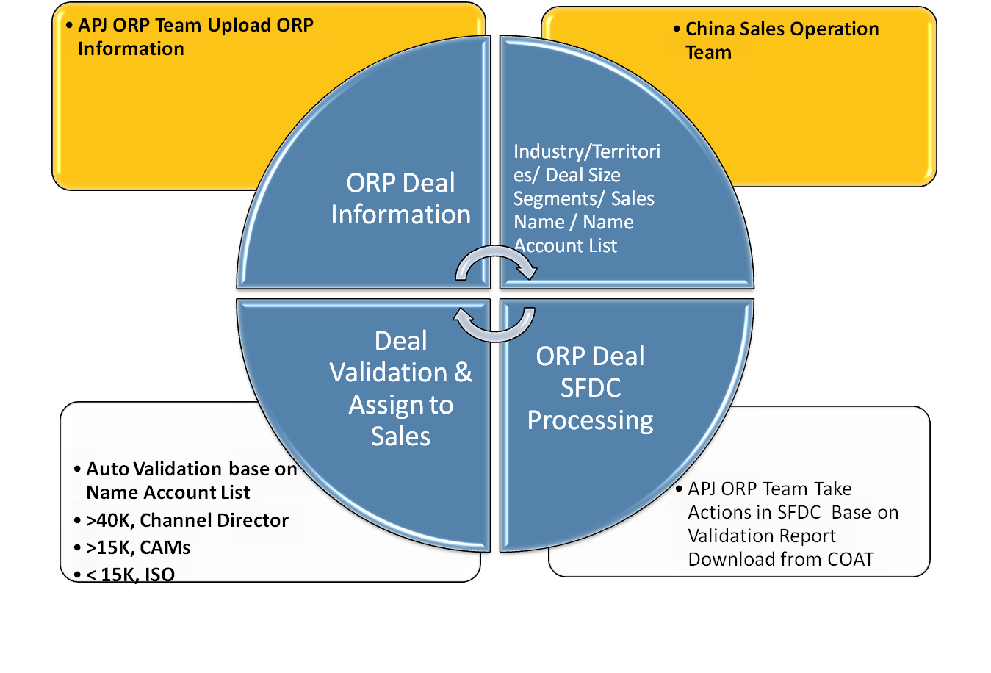
Data Resource & Supports Required by “COAT”
Smart Tool Overview Jul’11 – INTERNAL USE ONLY PLS

Slide 7
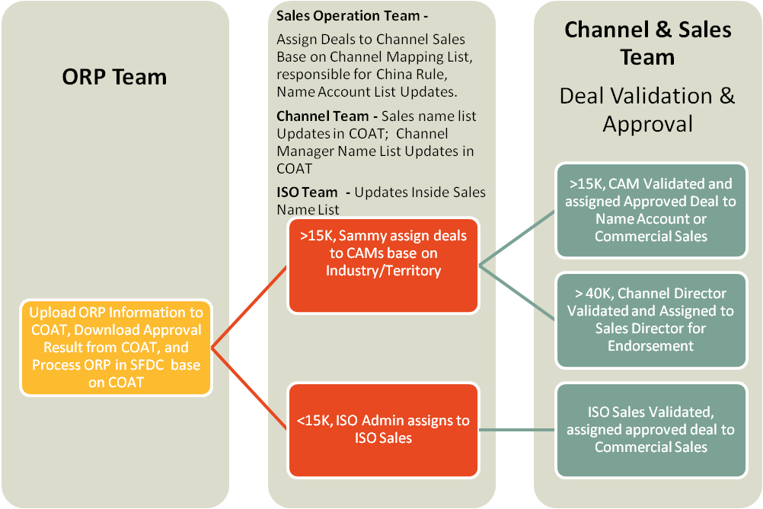
ORP Workflow – Needs to be replaced by “COAT”

Slide 8
Information Showing in COAT Platform
Level 1 Page
China Sub-Region
Channel Manager
ISO Sales
Deal ID | Partner Name | End User Name | Project Name | Deal Amount | Industry | Customer Province | Sales Operation | Channel / ISO Approver Name | Superior Level Approver ( if needed) | Status
1656612 | Technical Associates Inc. 上海并联科技有限公司 | 申银万国证券股份有限公司 | EV | 20K | FSI | Beijing | √ | √ | √ | Approved
Deal ID | End User Name | Effective Create Date Year and Qtr - Fiscal | Expiration Date Year and Qtr - Fiscal | Closure Date - Fiscal Year Qtr | Partner Owner | Partner Type | Product Name | Opp Industry | Approved Amount USD
1656612 | 申银万国证券股份有限公司 | 2012-Q1 | 2013-Q1 | 2012-Q1 | Technical Associates Inc. 上海并联科技有限公司 | Symc Platinum Partner | Enterprise Vault | Banking & Finance | 22222.2222
 | Validation Steps
1 | Check End User Name Base on Name Account List |  | √
2 | Check if Duplicated End User Name Base on Historical ORP Record |  | √
3 | Check if Duplicated Project Name Base on Existing End user Name |  | √
4 | Validated Correct Customer Located Province |  | √
5 | Validated Correct Customer Industry |  | √
6 | Assign to Right Sales Manager |  | √

Slide 9
Q&A

